Slide 1
Social Prescribing Link Workers A View From The Ground
Stephanie Driver
The Green Dreams Project CIC
Notes:
Good afternoon. My name is Stephanie Driver. I am the Business Manager for Green Dreams which employed a number of Link Workers between 2010 and 2015.

Slide 2
The Green Dreams Project…..
Set up in 2010 by Dr Fleming in response to a need he observed in general practice
Started with a single worker
Quickly grew to a team of 9
5 Link Workers based in GP practices
Grant and CCG funded
Hello!
Notes:
So I am going to speak to you about Green Dreams’ experience of Link Workers, which we called ‘Practitioners’. You might not know about Green Dreams so I am just going to rattle through a little introduction of the organisation and the work we did in relation to Social Prescribing.
READ SLIDE

Slide 3
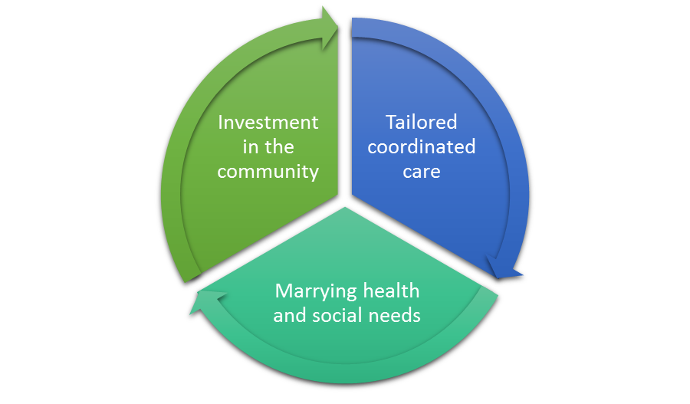
Challenges for the Organisation
Defining the nature of the work to others
Funding!
Demand vs capacity
Systematic monitoring
and reporting
Constant ‘invention’
Notes:
At the time of employing the Link Workers, Social Prescribing felt like a new concept to many of the organisations and GP practices we were working with and most didn’t realise the full scope of what we were there to do.
We always joke about this but defining what we did to others was always a challenge, quite simply because it could never be summed up in a single sentence.
In a nutshell we operated under a model which we called our triad of support. It involved an element of working with individuals to identify how they could be supported with their social needs which ultimately supported their health and wellbeing. We tailored the support we offered to every individual based upon their unique circumstances and worked with them to achieve their goals. We then took the work one step further by investing back into our community. This could be developing community assets which supported local people or continuing to work with patients as volunteers for community projects – either through Green Dreams or through a third party. This ultimately meant that we could support people back into work where appropriate by offering unpaid work experience and in many circumstances a reference for when they were actively seeking employment.
So as with everyone, funding was always a challenge and was restricted in equal measure, leading us to experience at times rising demand and not enough Link Worker provision.
Because the work was seen as so new and innovative, we also experienced difficulty with developing a systematic monitoring and reporting system. We knew what we did worked and that it had to be measured and reported on in a standard way but the challenge was how to do this. In the end we worked with a company called ‘Upshot’ to develop a bespoke monitoring database which recorded all patient information and supported our team to monitor both outputs and outcomes in a standard and systematic way. The follow on challenge to this was training the Link Workers on how to use it and refining it so that it didn’t get in the way of client support, but rather acted as a framework for use with patients.
And of course, our work was quite unique, so everything we did had to be continually invented and re-invented!

Slide 4
The ‘Link Workers’……
2 x Ex Public Servants
1 x Ex Social Worker
1 x Ex Theatre Nurse
1 x Ex Third Sector Support Worker
Professional. Diverse.
Good level of experience and knowledge.
1 Definite Common Trait:
To have a genuine interest and passion in supporting people
If you don’t like working with people, you’ll quickly leave!
Notes:
So that’s enough about Green Dreams as an organisation. Lets have a look at our ‘Link Workers’ or ‘Practitioners’ as we called them.
We had 5. There’s a photo of them there. They were quite a colourful bunch all in all.
We had
2 x Ex Public Servants
1 x Ex Social Worker
1 x Ex Theatre Nurse
1 x Ex Third Sector Support Worker
In a nutshell, they were all professional individuals from relatively diverse backgrounds but they all had a good level of experience of working with people in a supportive role and a good working knowledge of statutory, health and social care sectors. But the one thing they all did have in common was that they all had a genuine desire to support people and help those in need. They all used to say that if someone got a job at Green Dreams and didn’t like working with people, they wouldn’t last 5 minutes!

Slide 5
Support in Place
Open Door
Office Desk
Team Meetings
Support sessions
Annual Appraisal
Notes:
At Green Dreams we developed a support framework for our team and this was valued and appreciated by all staff, particularly the Link Workers. This consisted of:
A desk at the office to work from when needed
Weekly team meetings
Monthly staff support sessions where we looked at aims, objectives, plans, priorities, issues, concerns etc
Quarterly sessions as a group to look at case studies and successes
Annual appraisal
An open door policy – even if the door was the telephone when they were off site
So thinking about the purpose of the workshop today – developing the Link Worker role, I would say that all of this was essential to supporting the Link Workers and understanding their development needs.

Slide 6
Audit of Link Worker Support Needs
Notes:
So this brings me onto what I specifically want to present to you today. I want to give you a view from the ground of our experience of developing the Link Worker role and specifically what challenges we faced at Green Dreams. The scope of our experiences is limited to our organisation but nevertheless no doubt familiar to those delivering social prescribing programmes and serve as experiences which might help us to understand what is needed to develop the Link Worker role going forward.
On the slide you’ll see a graph which summarises an audit I undertook of the support session notes with our 5 Link Workers. I looked at the notes from May 2014 to May 2015 – a full year and I have categorised the points they raised in relation to their concerns, development needs and items discussed. It’s a simple slide but one which took several hours to produce as I am sure you can imagine. You can see there were some notable challenges brought to light by our 5 Link Workers but what I want to do is drill down into each one and outline the challenge faced, what local measures we took to overcome them and what opportunities exist to learn from this to help develop the Link Worker role. This then directly feeds into the question of what do we need to make social prescribing mainstream and sustainable in the long term.

Slide 7
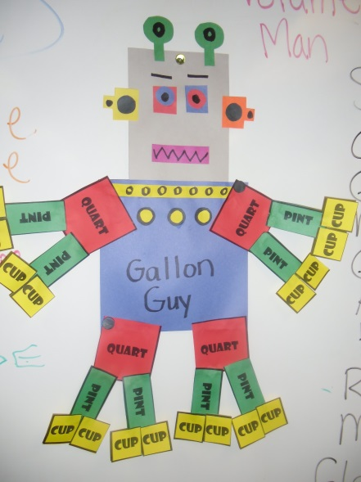
Challenge: Managing rising volumes of
clients and the need to feed back
to GP regularly
Measures: Waiting lists, prioritising those
most in need with ‘traffic light referral system’, reducing marketing activity, standardised feedback forms on patient record systems for direct input
Opportunities: Standardised monitoring to support ‘mindful commissioning’ and national statistical collections
Notes:
We always said it – a good Link Worker will always shoot themselves in the foot by doing a great job with a client and then getting a whole barrage of referrals on the back of the feedback given to the GP by the Link Worker themselves and the patient.
Inevitably any effective programme of support will attract rising volumes of referrals and in the case of the Link Workers who fed back to the referring GP for every patient, balancing the need for patient support with the ‘follow up admin’.
There is from our perspective one major opportunity here and that is to develop a standardised monitoring framework or guidance on how this should be done locally. It could also be developed to incorporate a short annual national statistical return so that from a national perspective we have some comparable data sets that helps us to understand from a local, national and regional perspective, what the demand is and to some degree what the benefits are. Ultimately, this could help to inform the commissioning of these services and to identify any gaps or any need for further development and investment.

Slide 8
Challenge: knowing when
support is concluded
Measures: Effective agreed action plans with patient, The Bolam Test, developing cross referral procedures with other agencies
Opportunities: Effective training for Link Workers and introduction of levels of SP
Notes:
Boundaries.
It was a big concern for those who expressed this as an issue. How do you know when your work with a patient is done? Some were quite comfortable with this but 3 of our Link Workers continually struggled with this notion of how much help is enough.
Locally, we introduced an action plan template for use with patients which identified what they wanted to achieve from their involvement in the programme and from this it became clear when the support was concluded. This was absolutely essential as demand rose and especially during busy periods. It also gave us an opportunity to fully co-design support with patients, delegating as much as was appropriate to the patient to complete.
We also as a team used the Bolam test to decide when enough was enough, where Link Workers ask themselves ‘could I do more’ before concluding an action plan and to support this we developed a range of cross referral procedures with other agencies to streamline referrals on to other organisation for specialist support.
So this brings me onto a big opportunity point – training! For us, to have a specific training session for Link Workers who have gone a long way to addressing the concern as would the introduction of a range of ‘levels’ of social prescribing which has been mentioned in the SP toolkit which was recently published. I’ll speak more about training on the next slide.

Slide 9
Challenge: Vast range of training needs (see matrix)
Measures: Sourcing courses locally and developing in house training to build up package
Opportunities: Standardised SP training involving a range of teaching / learning methods so learning can be embedded through practical application, discussion and challenge. Career progression routes.
BUT there is no substitute for classroom learning!
Notes:
So as I have alluded to, training was a big challenge for our Link Workers. I have put out a paper for you all which outlines the training matrix we developed for Green Dreams. You can see on this that we took training very seriously, not least because it gives better results for patients but also because it leads to greater job satisfaction and supports workers with their long term development.
If you look at the matrix you will see that many of the courses were developed and delivered in house which was far from ideal in all circumstances and this was just driven from a cost and lack of availability perspective. The other courses were sourced from a range of providers on an ad-hoc basis. The big but here is that had there been a Link Worker training programme available to us, this would have saved significant costs and time associated with arranging and attending. Had this been provided as a programme, it would also have meant that the Link Workers not only felt supported and valued, but would have supported recognition of their role and scope with the community, other organisations and GP practices.
A Link Worker training programme could also pave the way for career development.

Slide 10
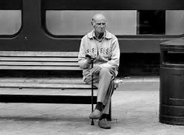
Challenge: Link Workers being
based in GP Practices with reduced team contact
Measures: Regular team meetings, support and supervision. Office desk available, introduction of ‘Friday Download’.
Opportunities: National association of SP Link Workers?
Notes:
This will perhaps come as no surprise but our Link Workers did work in isolation for much of their time. They were based in GP practices and largely working with patients on a 1:1 basis. They did feel isolated at times and it’s a risk for any Link Worker. Not only can it contribute to feels of being undervalued but it can affect motivation and make it difficult to work on team projects such as networking, awareness raising and developing partnerships.
We did the usual really to tackle this – team meetings and support and supervision sessions. We also introduced ‘Friday Download’ where everyone had their lunch in the office on Fridays and used the time to unofficially catch up on news and with colleagues. This worked well, but I feel that the opportunity going forward here is to develop some form of national association of Link Workers to link them all up. We have national associations for nurses, managers, business owners a variety of other professions, so if the Link Worker role is to develop surely there is room to start something for Link Workers – however informal. Big trees grow from small acorns so perhaps this could be kicked off with a Facebook group even before becoming more developed.

Slide 11
Awareness of Local Services / Partnerships / Networking
Challenges: Co-ordinated development of networking, developing awareness of local services and formal partnerships
Measures: Included as team meeting agenda item and discussed in staff support. Development of a standard cross referral procedure and partnership agreement.
Opportunity: Connect them up!
Development of regional
social prescribing networking events and
regional newsletter / FB page for
Link Workers – modelled on Chamber
of Commerce?
Notes:
So this slide follows directly on from the previous one. Our Link Workers were too absorbed at times in patient facing work that the networking and partnership development side often fell to the wayside a little. To overcome this challenge we began to look at this organisationally during team meetings, rather than letting geography ‘carve up this work for us, based on the locations the Link Workers covered which ultimately creates overlaps and gaps.
We developed some templates for creating standardised cross-referral systems and a template partnership agreement. This not only sped up meetings to identfiy how we could work in partnership with other agencies but set out expectations from the start
So, the opportunity here is to build on what has been started today at the conference and develop some form of Link Worker network for information exchange and peer support as well as acting as a springboard for wider networking and building up a knowledge of what agencies and assets are available to patients locally to support their social prescription.
Quite simply, we need to find a way to connect up the Link Workers, perhaps starting simply with a newsletter or facebook group and building this into something which is modelled on Chamber of Commerce networks. Again this makes the Link Workers feel supported, valued and more widely recognised.

Slide 12
What’s in it for ME?
Challenge: referring in any quantity
to local 3rd sector agencies was
frequently met with this question!
Measures: Agreed cross referral
procedures and formal partnership
agreements. Raising awareness of the
scope of work.
Opportunities: National and regional awareness raising of SP and development of standardised ‘marketing materials’ / national website building on SP Toolkit and ‘levels’ of social prescribing.
Notes:
So I had to put this slide in. Perhaps this is something unique to our organisation but I suspect not.
Our Link Workers found that when referring in any quantity to third party organisations they were often met with the question of ‘What’s in it for us?’
I won’t lie – this was a challenge and one that I had never experienced before. It took a lot to overcome this and it started with raising awareness of our work so there was a clear understanding of the scope of what we did. We also introduced some formal partnership agreements with some organisations and some cross referral procedures. I never felt that this work was complete.
There is an opportunity here though. This challenge we experienced does demonstrate the need for more awareness raising of SP and more standardised language to support the definition and scope of what it does. This work has already started with the toolkit and the network however, it could be extended significantly to include some standardised marketing materials (perhaps on the back of the Link Worker’ networks) and perhaps a national website to explain the role. Explaining the different levels of SP as explained in the SP toolkit could also be publicised as part of this work.

Slide 13
What did the Link Workers Tell us?
Valued
Supported
Recognised
Notes:
So from this, in essence what did the Link Workers at Green Dreams tell us about how to develop the role going forward? For me it boils down to 3 fundamentals – that they need to be recognised nationally or at least on a larger scale, they need to be and be made to feel valued and they need support on a wider scale to underpin this.

Slide 14
Conclusion – The Opportunities
Monitoring
Training
National Association and marketing
Network
Notes:
The opportunities are clear from the experiences of Green Dreams. There is the opportunity for 4 key things developed and put in place:
Standardised monitoring and recording – or guidance at the least. We all know SP works after all, why complicate and dis-joint the monitoring with too many approaches on the same theme?
Effective training – no one needs to feel like their training programme is ad-hoc – it just de-values it and the role can be given greater recognition with the assurances of robust training programmes.
A network – let the isolated workers join up and provide peer support and share information
A national association and marketing for the role – perhaps last on the to-do list but important all the same

Slide 15
THANK YOU!

